Slide 1











Gecat Summer Training 241
Undergraduate Degree in Management Information System
Summer Training
Semester 233 – MIS-399
Name: Mujtaba Zaman
ID: 202132090
Due Date: 13/October/2024
Week: 8 - 241
Coop Advisor: MR. EHAB ABDULLATIF QAHWASH
Coop Supervisor: Alyazid Alhumaydani

Slide 2










Outlines
Gecat Introduction
Journey Management System
Problems with data entry
Task 1 Making website
Gecat Infrastructure, DP, ICT Tech
Task 2 FAS Oceans Jisr Report
FAS Infrastructure, DP, ICT Tech
Task 3 Excel to Form to Excel
Conclusion
Notes:
2

Slide 3

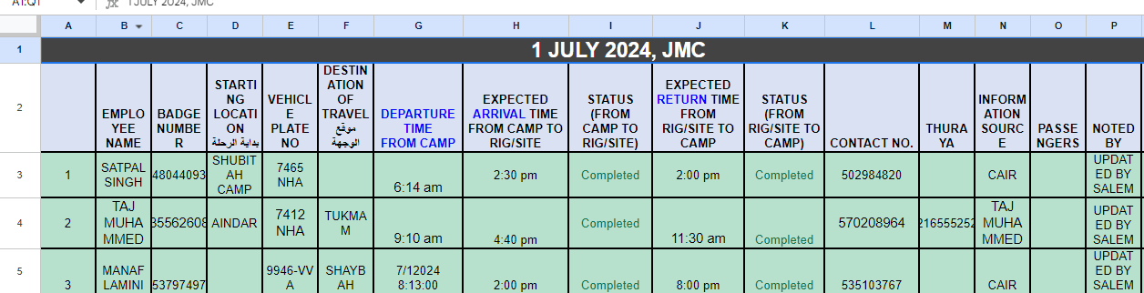
Introduction
Worked in Gecat Company in department of Journey Managment
They used Google Sheets to store records of deliveries
I made solutions to help the company be more efficient in storing records
It included making website using HTML, PHP and MySQL.
Alternatively, using Google Forms to add records to excel file
I also went to FAS Oceans office where our main summer training tasks were done
This presentation will talk about what I did in the summer training

Slide 4
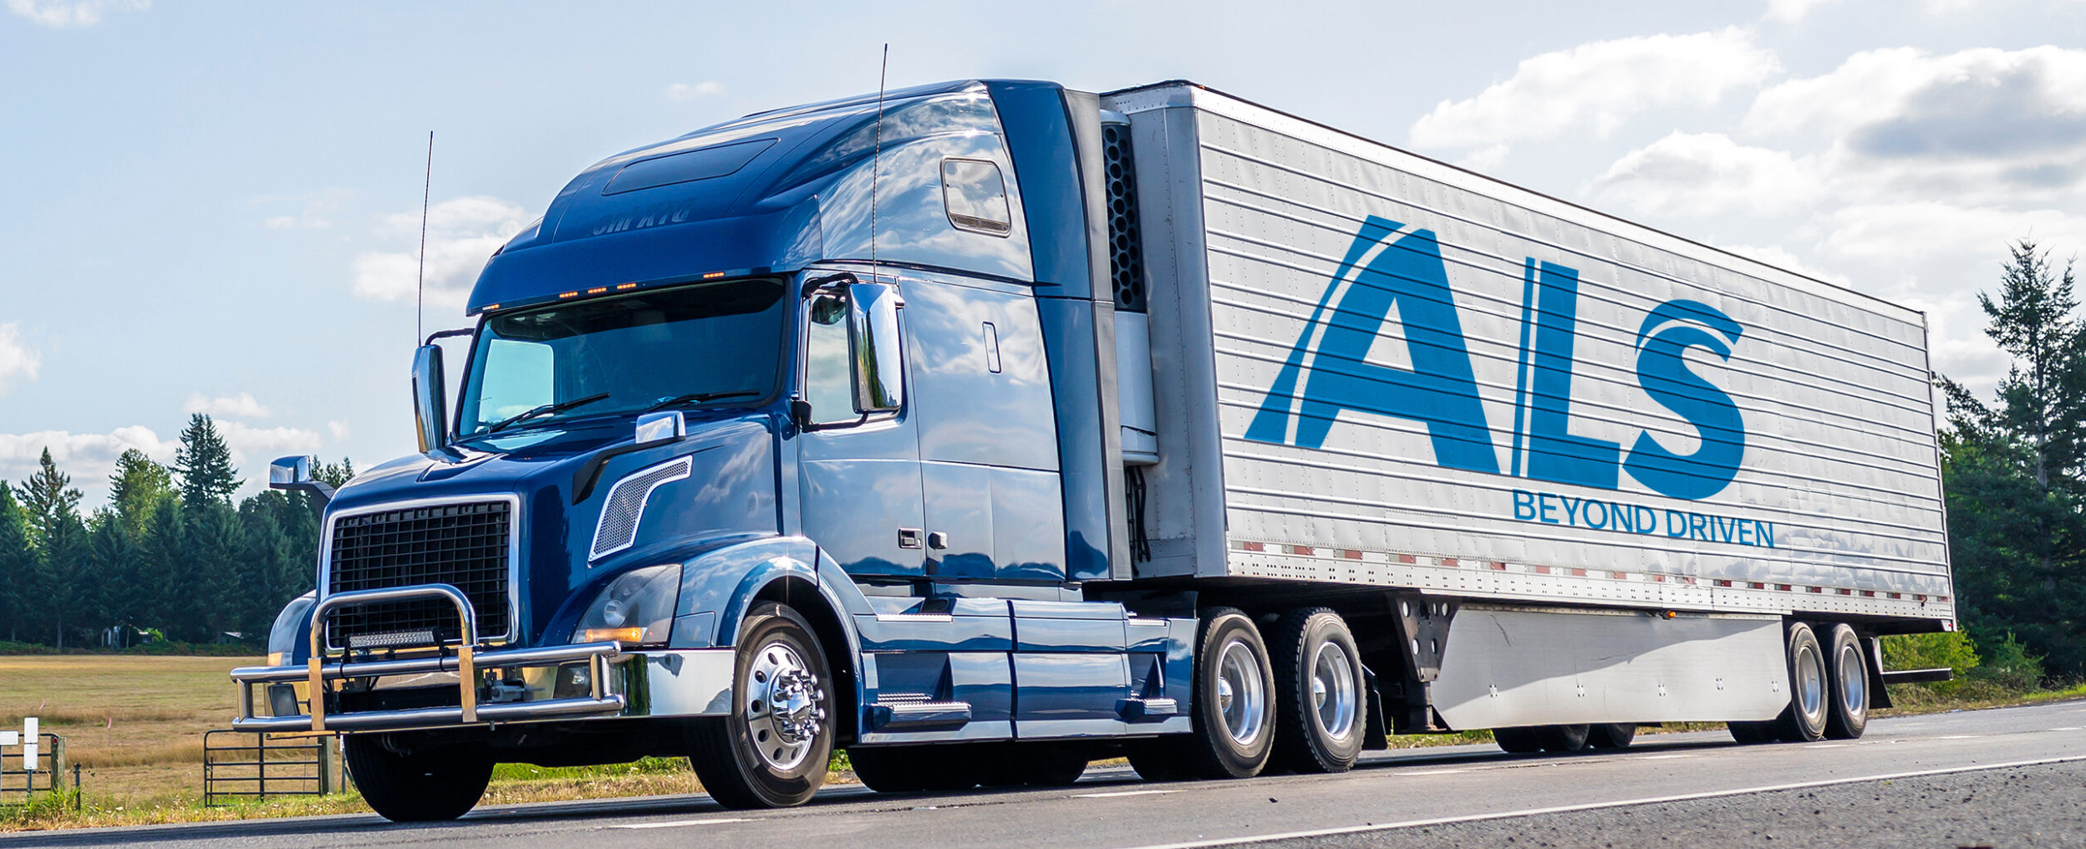



Gecat
It works with Aramco to provide pre-site operations
It has many departments in different buildings
I went to Journey management system and HR Department under the name of FAS Oceans

Slide 5
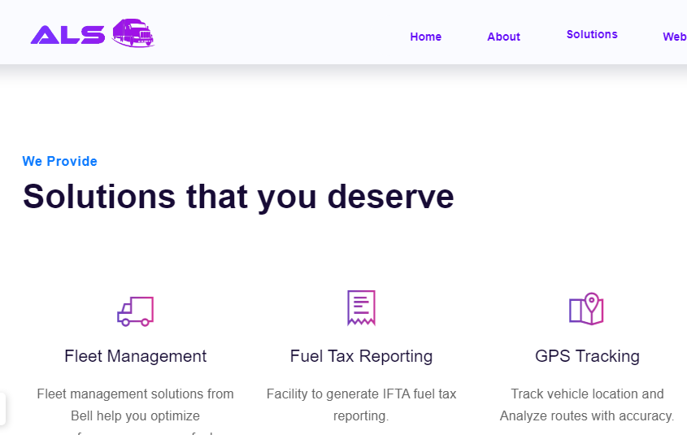
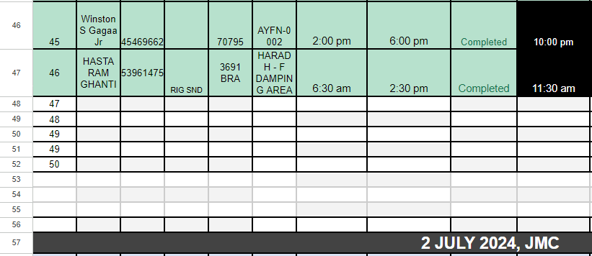
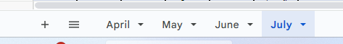
Gecat Journey Management System
Use google sheets to record different deliveries
Is getting harder to manage 50+ deliveries
Records are put when a delivery is more than 100 to 150 KM long
Need to record delivery for all deliveries
The driver send paper form to JMS team through WhatsApp, then JMS team enters the data into Excel
Manual entry can introduce mistakes in the system.

Slide 6
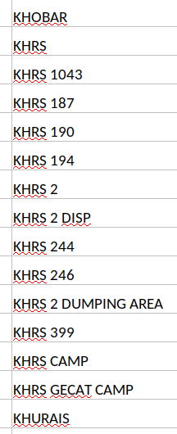
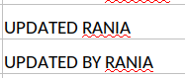
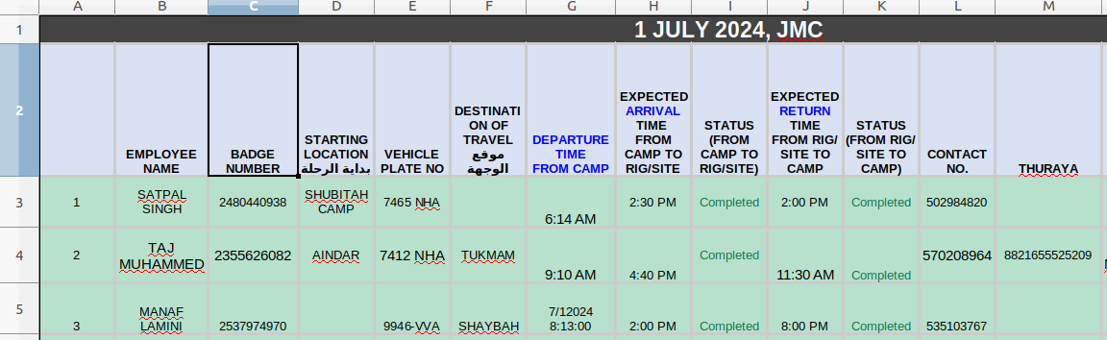
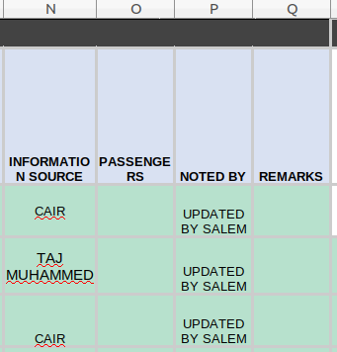
EMPLOYEE NAME
BADGE NUMBER
STARTING LOCATION بداية الرحلة
VEHICLE PLATE NO
DESTINATION OF TRAVEL موقع الوجهة
DEPARTURE TIME FROM CAMP
EXPECTED ARRIVAL TIME FROM CAMP TO RIG/SITE
STATUS (FROM CAMP TO RIG/SITE)
EXPECTED RETURN TIME FROM RIG/SITE TO CAMP
STATUS (FROM RIG/SITE TO CAMP)
CONTACT NO.
THURAYA
INFORMATION SOURCE
PASSENGERS
NOTED BY
REMARKS
Problems:
Manual Data entry leads to spelling mistakes
Mistakes in badge number that is 10 digits long could also be found
Better solution can be to use dropdowns
To store multple attribuites of a person can be stored using database instead of excel

Slide 7
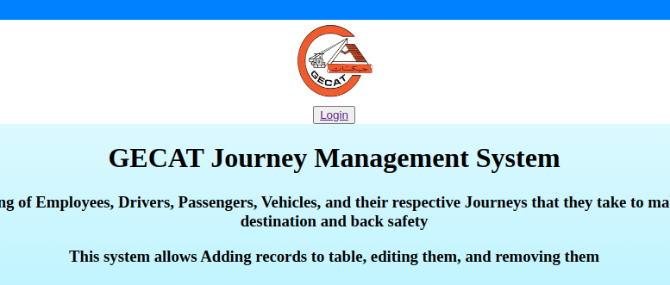

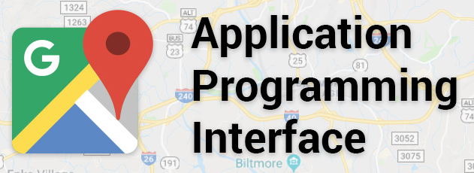
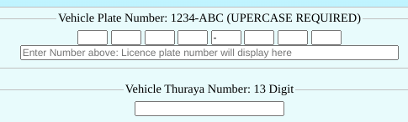
Task 1 Making Website
Adding, Editing, Removing Record from Table
Google Map API, Leaflet API to use for address input
Used some JavaScript to control number of items to be entered in one input and to implement APIs
Some CSS Styles to add colour to website and edit positions of elements
Files include: index.php, config.php, login.php, admin.php, user.php, passengerform.php, passengerprocess.php, etc.

Slide 8

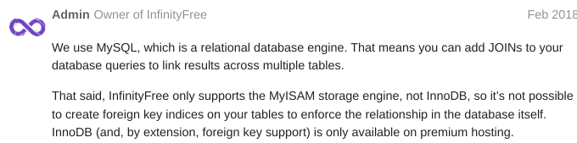


Task1: Tools used
HTML – forms,
PHP – for implementing database integration
FTP – for editing the website
MySQL – the database used, older version without relationship integrity, it needed to be coded in
Linux – OS that runs the above-mentioned programs, used it to install programs and run the website (shown in appendix of the report)
InfinityFree – Platform that has the website hosted on, it provides tools to edit the site

Slide 9
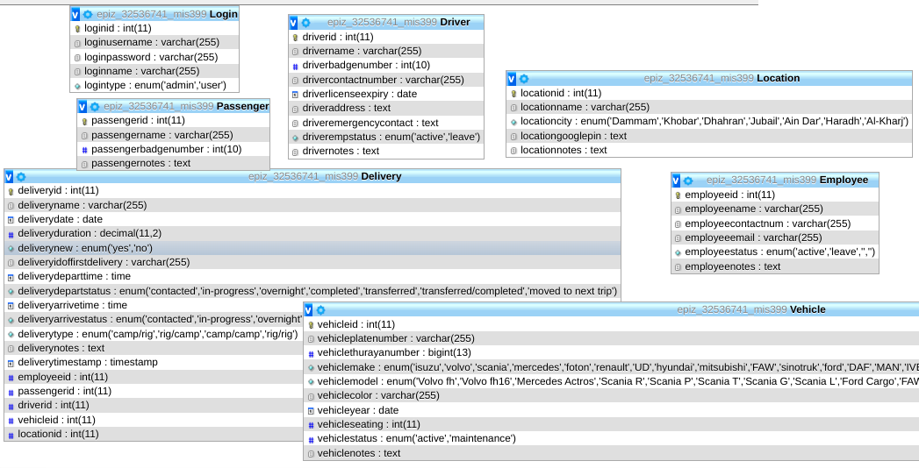

Slide 10
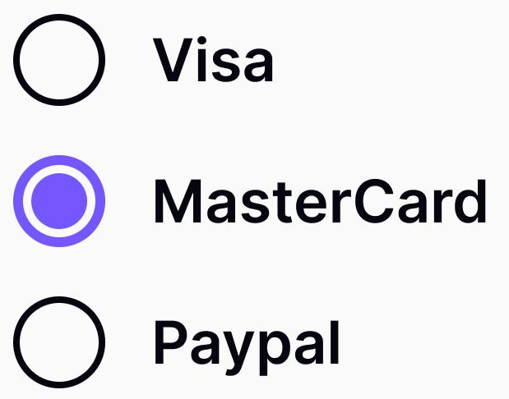
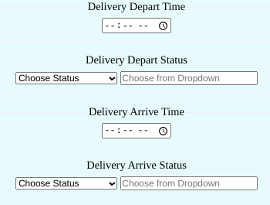
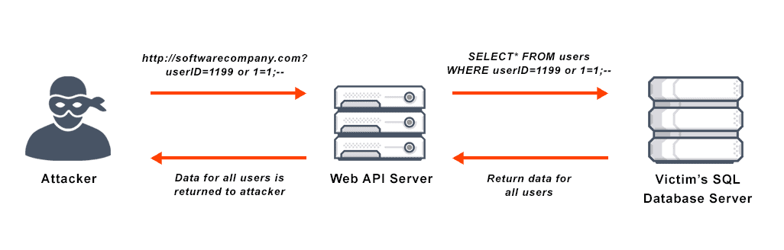
Task 1 Problems in Website
Security problems as no parameters used, vulnerable to SQL injection
Bugs in the Website like editing some fields may remove information from record
Un refinement, will allow you to do whatever you want, dates misalignment will not raise a flag
Generic Design that might not be intuitive to use

Slide 11

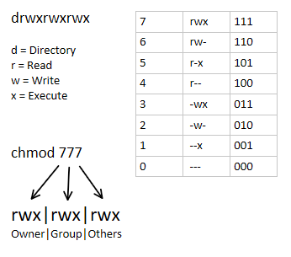
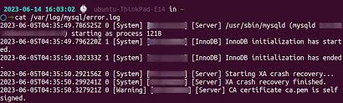
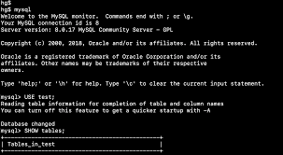

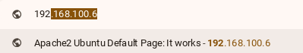
Task 1 Implementing in a Server
Installed Ubuntu Server on a Laptop to run website offline.
Installed Programs like Apache, PHP, PHPMyAdmin, MySQL.
Configured these programs.
Transferred files from InfinityFree to Local Server
Also touched on some chmod elements
There are some problems in PHP integrations

Slide 12
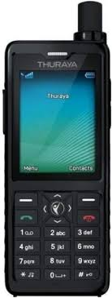


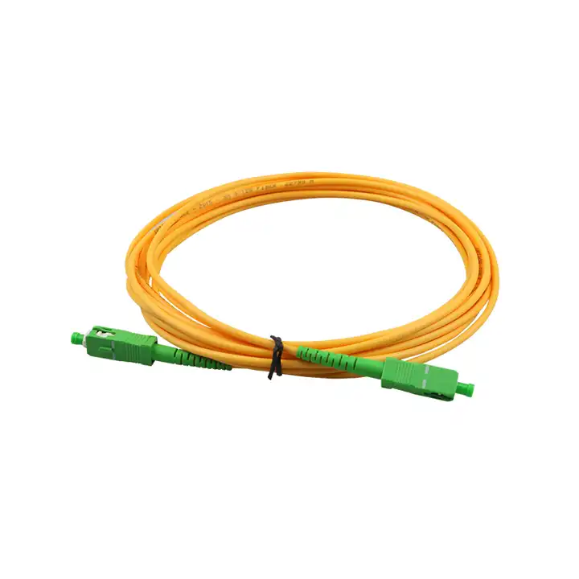

Gecat Infrastructure, Digital Platforms, ICT Tech
Many BYOD devices and PCs Used
Network device used was Huawei HG8245W5 with Gigabit fibre optic connection (GPON), there was also 2 devices used
Digital Platforms are Gmail, Google Sheets and WhatsApp
ICT Technologies used were ALS (Arethos Logistics System) for tracking trucks in real time when internet is available
Thuraya Device that offer truck drivers GPS connection to contact support when internet is not available.

Slide 13
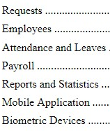
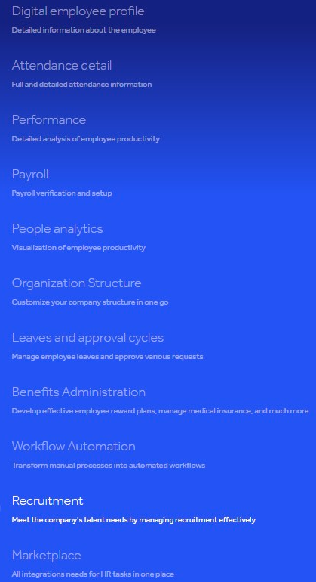

Task2 FAS Jisr Reports
3 Reports in Total
Analyse the Jisr Modules
Analyse how Jisr Platform is used in the Gecat company
Provide Recommendations and Feedback for Improvements
This was the official requirements from the Gecat for our summer training.

Slide 14
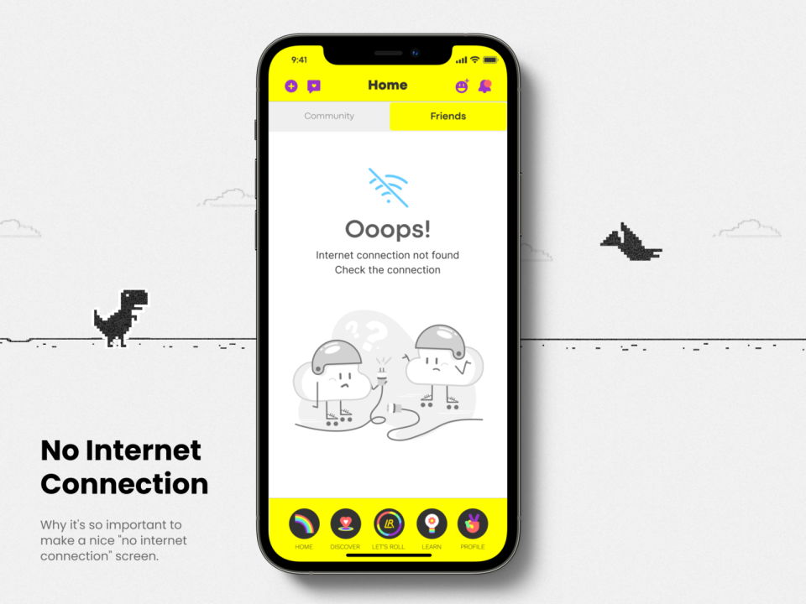

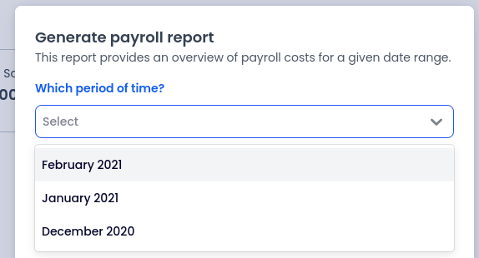
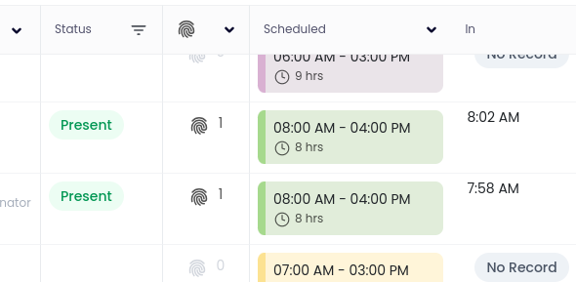
Task2 FAS Jisr Problems Found
Mobile application attendance
double clock-ins that override the first clock-in and no record of first one
manual clock-out doesn't clock out automatically when away from location at end of day
Mobile application needs internet connection always
Phone battery drain due to phone tracking due to attendance
Missing/incomplete data for payroll part of Jisr
Biometric attendance is not completely implemented

Slide 15
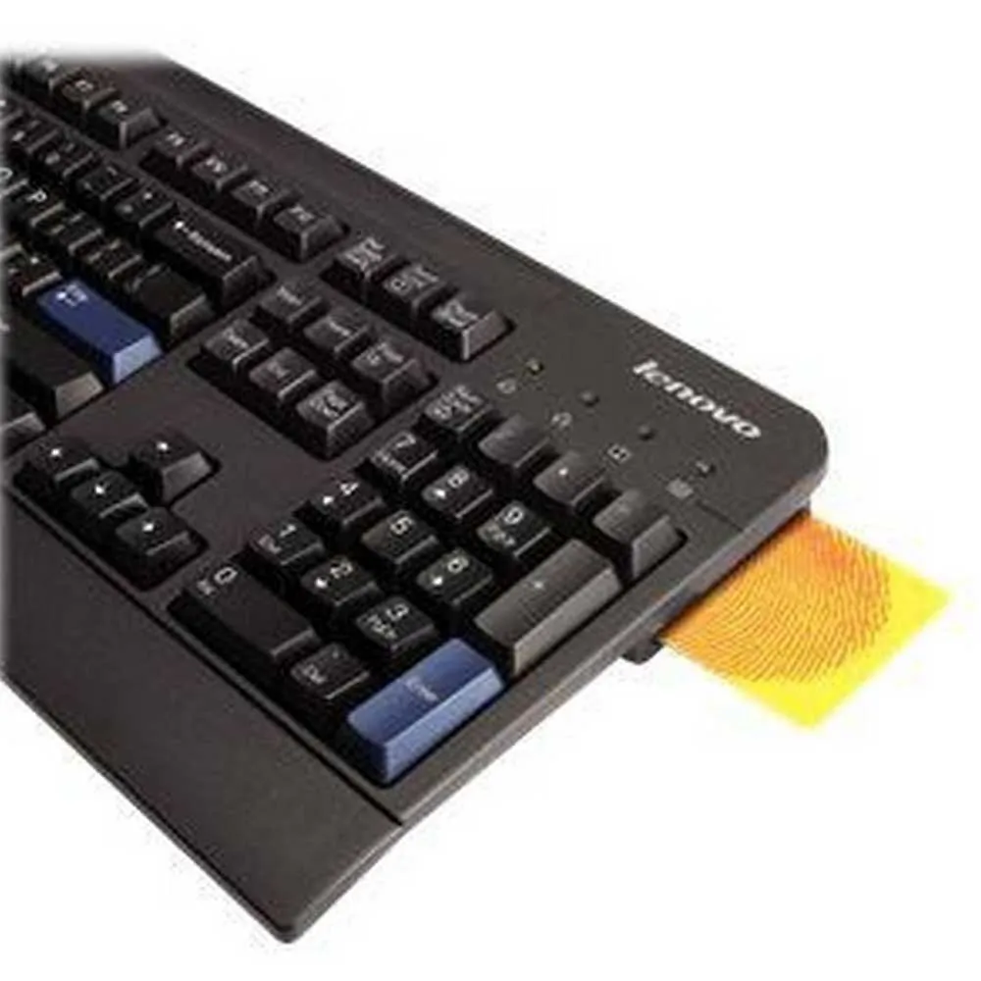








FAS Infrastructure, Digital Platforms, ICT Tech
Around 7 PCs used in the office that were SFF ThinkCentre with Intel I7 5th generation Black Edition and windows 11 installed
22inch Full HD Monitor with Camera and Mic Built in that was used for interviewing new applicants
Network was one ZAIN BROVI H155-381 Router that is a Wi-Fi styled router

Slide 16
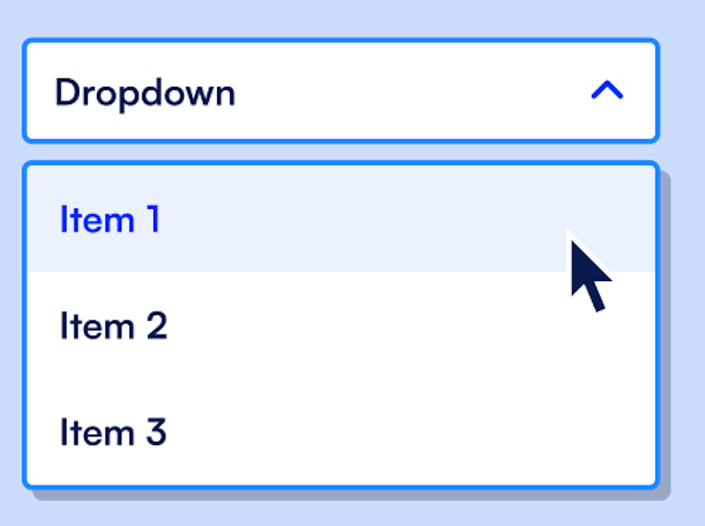


Task3 Sheets to Form to Sheets
Used google Forms to Fill user information but inputting names manually can cause spelling mistakes
Using dropdowns is better, but putting names manually can take long time.
To solve dropdowns, make another google sheet, connect google form and google sheet using App script language
Now updating google sheet will add new record in dropdowns which allows adding hundreds of records in dropdown form.

Slide 17
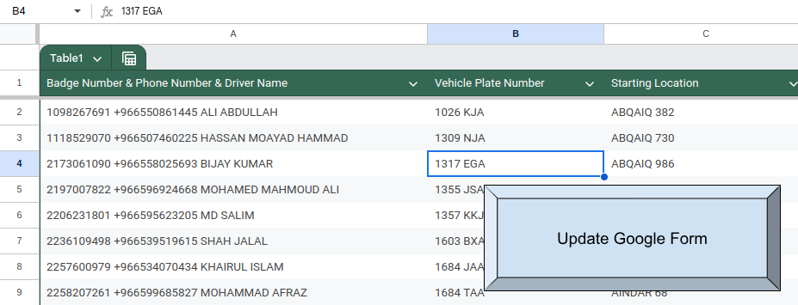
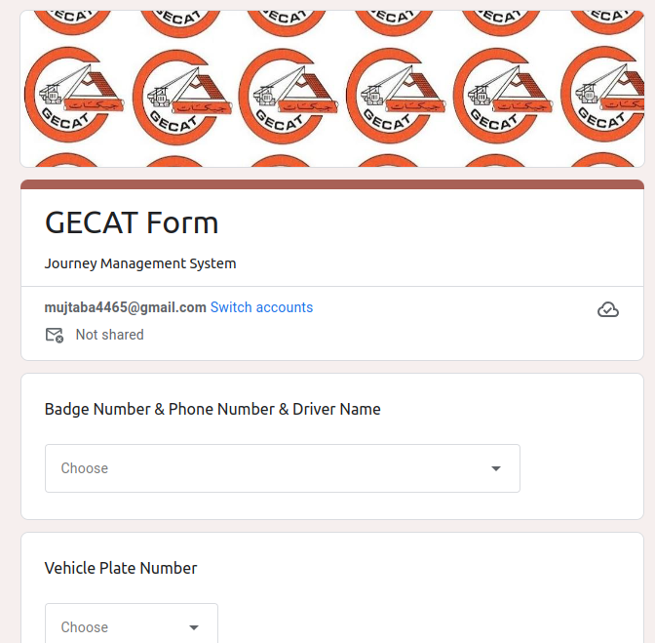
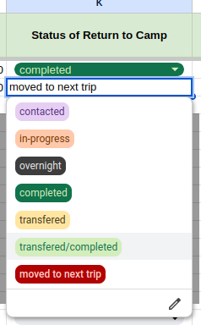
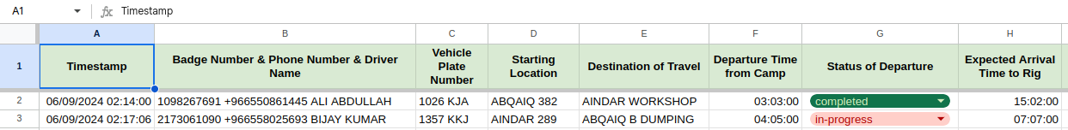
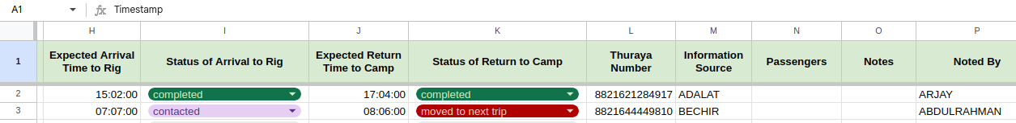
https://docs.google.com/forms/d/e/1FAIpQLScVtjTWKj3zHEgDvC5mqedudZgBsPcG5iu3sPrAYr9DAevXwQ/viewform?usp=sf_link

Slide 18
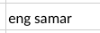
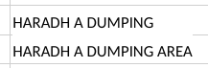

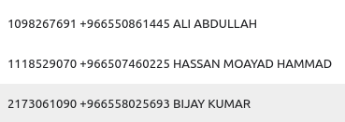
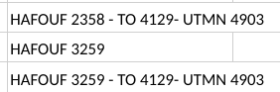
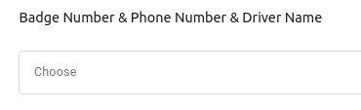
Task3 Excel to Form to Excel
Found the Google Sheet company was using, the data was not clean, there was spelling mistakes leading to multiples of the same record
I decided to clean using Badge Number being the main tag to clean records
Badge Number, Phone Number, and Name are combined but is sorted by badge Number
Sorting is used to make it easier for employees to enter data.

Slide 19


Task3 Excel to Form to Excel
This is simpler to maintain than website
It is also easier to understand for company employees
There is a lack of control compared to website like editing previous submissions from the form is not possible
Need three people to work
One work on adding new people in the form backend sheet
One person adds the deliveries in the main form
Another person edits the status of deliveries in the output form sheet
Can become cluttered if you want to keep lots of information

Slide 20

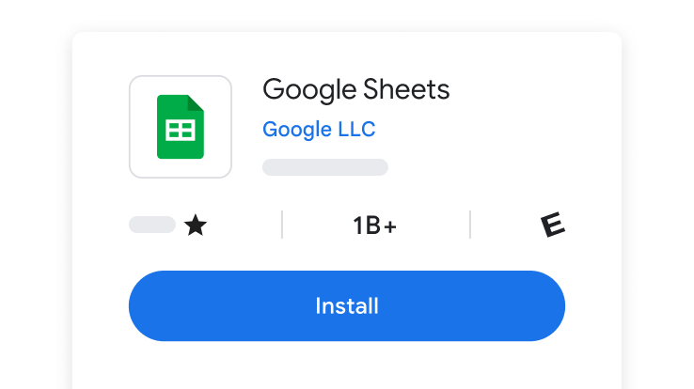


Conclusion
The form is the most refined solution for the JMS team
Still need to fix some bugs in the website
I learned many new skills from this summer training like PHP web development, making login page on web, etc.
This was a very helpful experience for me and will help me in my future career.

Slide 21

References
All pictures are taken from google.
https://www.php.net/
https://www.w3schools.com/html/
https://www.w3schools.com/css/
https://code.visualstudio.com/
https://www.jisr.net/en
https://developers.google.com/apps-script
https://workspace.google.com/products/sheets/
Notes:
14

Slide 22


Slide 23






Presentation Ended Thank you for Listening and Watching

